Slide 1

IOT ENABLE GAS LEAKAGE DETECTION SYSTEM
Group No. 02
Shailesh Maurya 17204008
Sankalp Patil 15104030
Akash Sapkal 16204035
Project Guide and Co-guide
Prof: Apeksha Mohite
Prof: Sonal Jain

Slide 2
Contents
Abstract
Introduction
Objectives
Literature Review
Problem Definition
Existing System Architecture/Working
Proposed System Architecture/Working(Flow diagram that depicts the start to end modelling)
Technological Stack(if any)(May be revised in Sem VII)
Scope of your project
Project Limitations (if any identified)
References

Slide 3
Abstract
The aim of this project is to present such a design that can automatically detect and also stop gas leakage in vulnerable premises
To stop accident associated with the gas leakage is to install gas leakage detection kit at vulnerable places.
Gas leakage is a major problem with industrial sector, residential premises and gas powered vehicles.
Gas leakage system consist of GSM module, which warms by sending SMS.
The Particular gas sensor has been used which has high sensitivity for Propane(C3H8) and Butane(C4H10).

Slide 4
Introduction
Gas Leakage detector is a simple system that is designed to detect and notify any leakage of natural gas or any other flammable gas.
Although these gases do help the man, but it is also equally dangerous when not taken care of them.
If we seek out the recent accidents that happen in house due to gas leak,we will be seeing a handful of them.
Well Coming to the point, we have come up with the solution to at least control them.

Slide 5
Objectives
LPG gas which used in many applications because of its desirable properties like homes, hostels, industries, vehicles so we can use this device to detects gas leakage.
This system automatically alert the people by sending the message and alert the people at home by activating the LCD, BUZZER.
It also take the necessary action of preventing the gas leakage.
A webserver is developed for continuous monitoring of the sensor's value.

Slide 6
Literature Review
Paper Title : An IoT based System for Domestic Air Quality Monitoring and Cooking Gas Leak Detection for a Safer Home
Authors: Kalpesh Gupta, Gokul Krishna G and Anjali T
Publication details : International Conference on Communication and Signal Processing, July 28 - 30, 2020, India
Findings: https://ieeexplore.ieee.org/document/9182051
Advantages: Proposing a hybrid low cost low power IoT based system for air quality determination and cooking fuel leak detection, enhancing the safety of the users in the house.
Disadvantages: Person don’t get any alert message or any alarm.

Slide 7
Literature Review
Paper Title : Automatic Smart and Safety Monitoring System for Kitchen Using Internet of Things
Authors: Harika Pudugosula Student, Master of Technology Computer Science and Engineering Amrita School of Engineering, Bangalore Amrita Vishwa Vidyapeetham, India
Publication details : Proceedings of the International Conference on Intelligent Computing and Control Systems (ICICCS 2019) IEEE Xplore Part Number: CFP19K34-ART; ISBN: 978-1-5386-8113-8
Findings: https://ieeexplore.ieee.org/document/9065663
Advantages: The sensor used in this model can sense and detect the leakage of the gas, and the user gets notification regarding gas leak.
Disadvantages: To uploads the value into web server it requires the Wi-Fi module.

Slide 8
Problem Definition
Gas leakage leads to various causality resulting into both financial loss as well as human life.
In human’s daily life, environment plays a vital role in health issues. The risk of fires, suffocation, explosion all are based on their physical properties such flammability, toxicity etc.
The number of deaths figures due to explosion of gas cylinders has been increasing in recent years.
The main reason for such explosion is due to sub-standard cylinders, worn out regulators, old valves and lack of awareness using gas cylinders add to
risks.

Slide 9
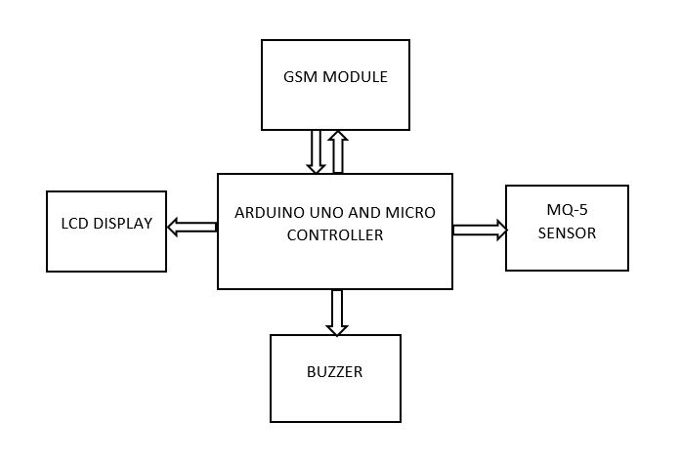
Existing System Architecture/Working

Slide 10
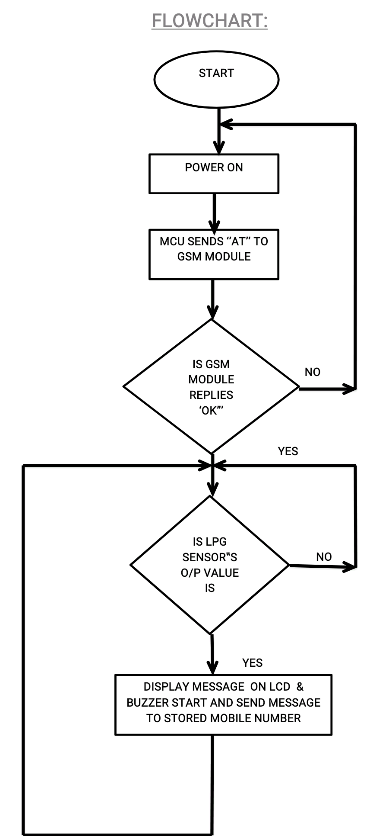
Working

Slide 11
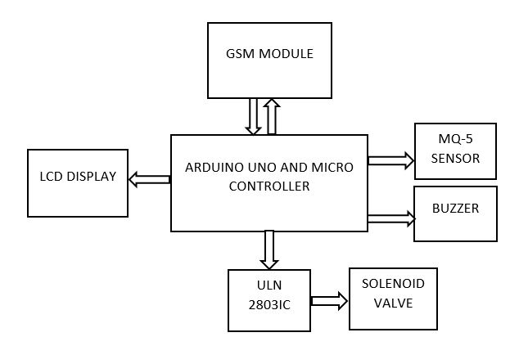
Proposed System Architecture/Working

Slide 12
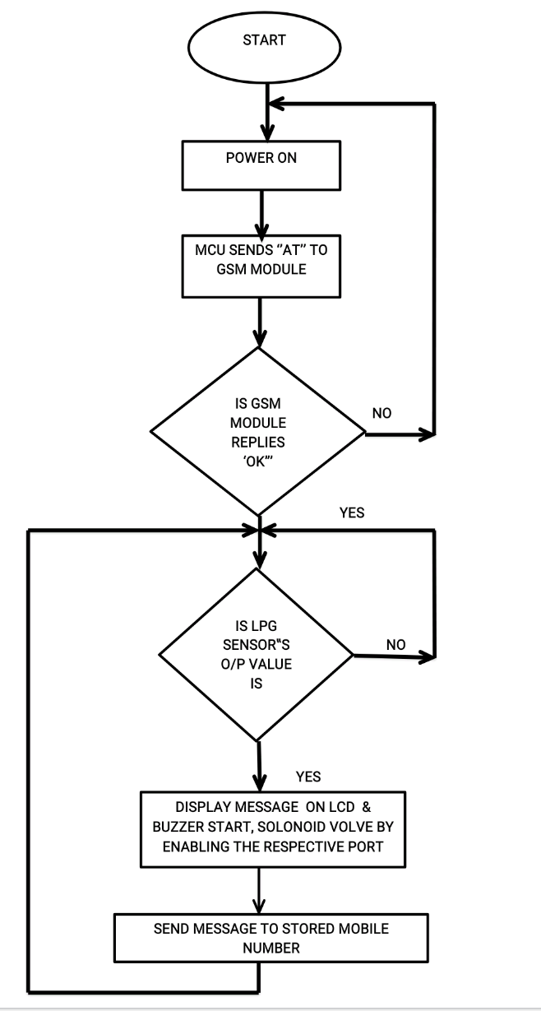

Slide 13
WebServer
A webserver is developed for continuous monitoring of the sensor's value. ESP2866 makes an HTTP post request to a PHP script to insert sensors value into a database.
A specific domain name and hosting space are required for reaching out to the webserver.
A MySQL database is prepared for storing data from the sensors. A PHP script is developed for inserting the data into the MySQL database.
The user can monitor the value of the sensor from anywhere by accessing the web address

Slide 14
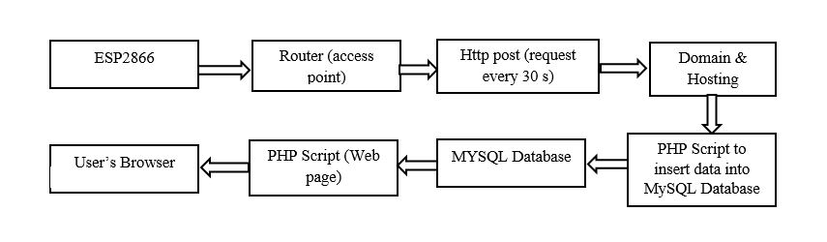
WebServer Process Block Diagram

Slide 15
Scope of your project
Our system of gas leak detector can also be upgraded. There are many relevant options that can be implemented
The current system gives us notifications of leakage and also stop flow of gas.
This system can be further more upgraded to a compact version where a
mini- speaker can be used, less wiring and many other similar upgrades
can be made.

Slide 16
Thank You...!!

